Slide 1

Permutation test – HW6
-Nitin Gowda

Slide 2
As a bijection from a set to itself, a permutation is a function that performs a rearrangement of a set, and is not a rearrangement itself. Permutation tests can be used for analyzing unbalanced designs and for combining dependent tests on mixtures of categorical, ordinal, and metric data. They can also be used to analyze qualitative data that has been quantitized. Permutation tests may be ideal for analyzing quantitized data that do not satisfy statistical assumptions underlying traditional parametric tests
What is the permutation function?

Slide 3
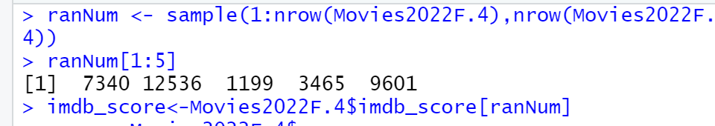
Using the RanNum fuction, an array or a selection of 5 numbers are made from the movie database. The hypothesis from hw5 is then used to test with the permutation function.
Procedure

Slide 4
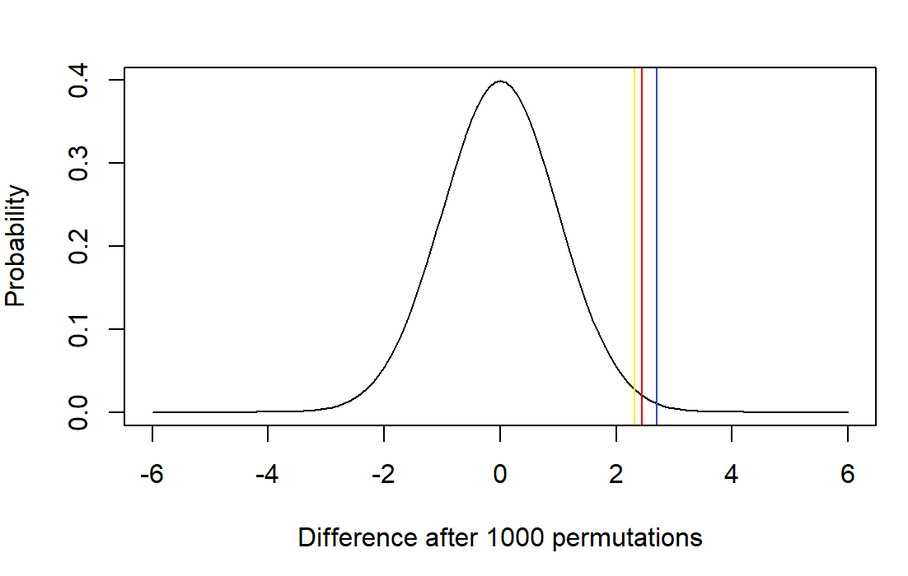
On running the permutation function 3 times, 3 p values are found and plotted against their probabilities.
P values found

Slide 5
The p values found after plotting are: 2.1, 2.2, and 2.6 These values line up with the variables used, and is therefore correct.
P values found (continued)

